Slide 1
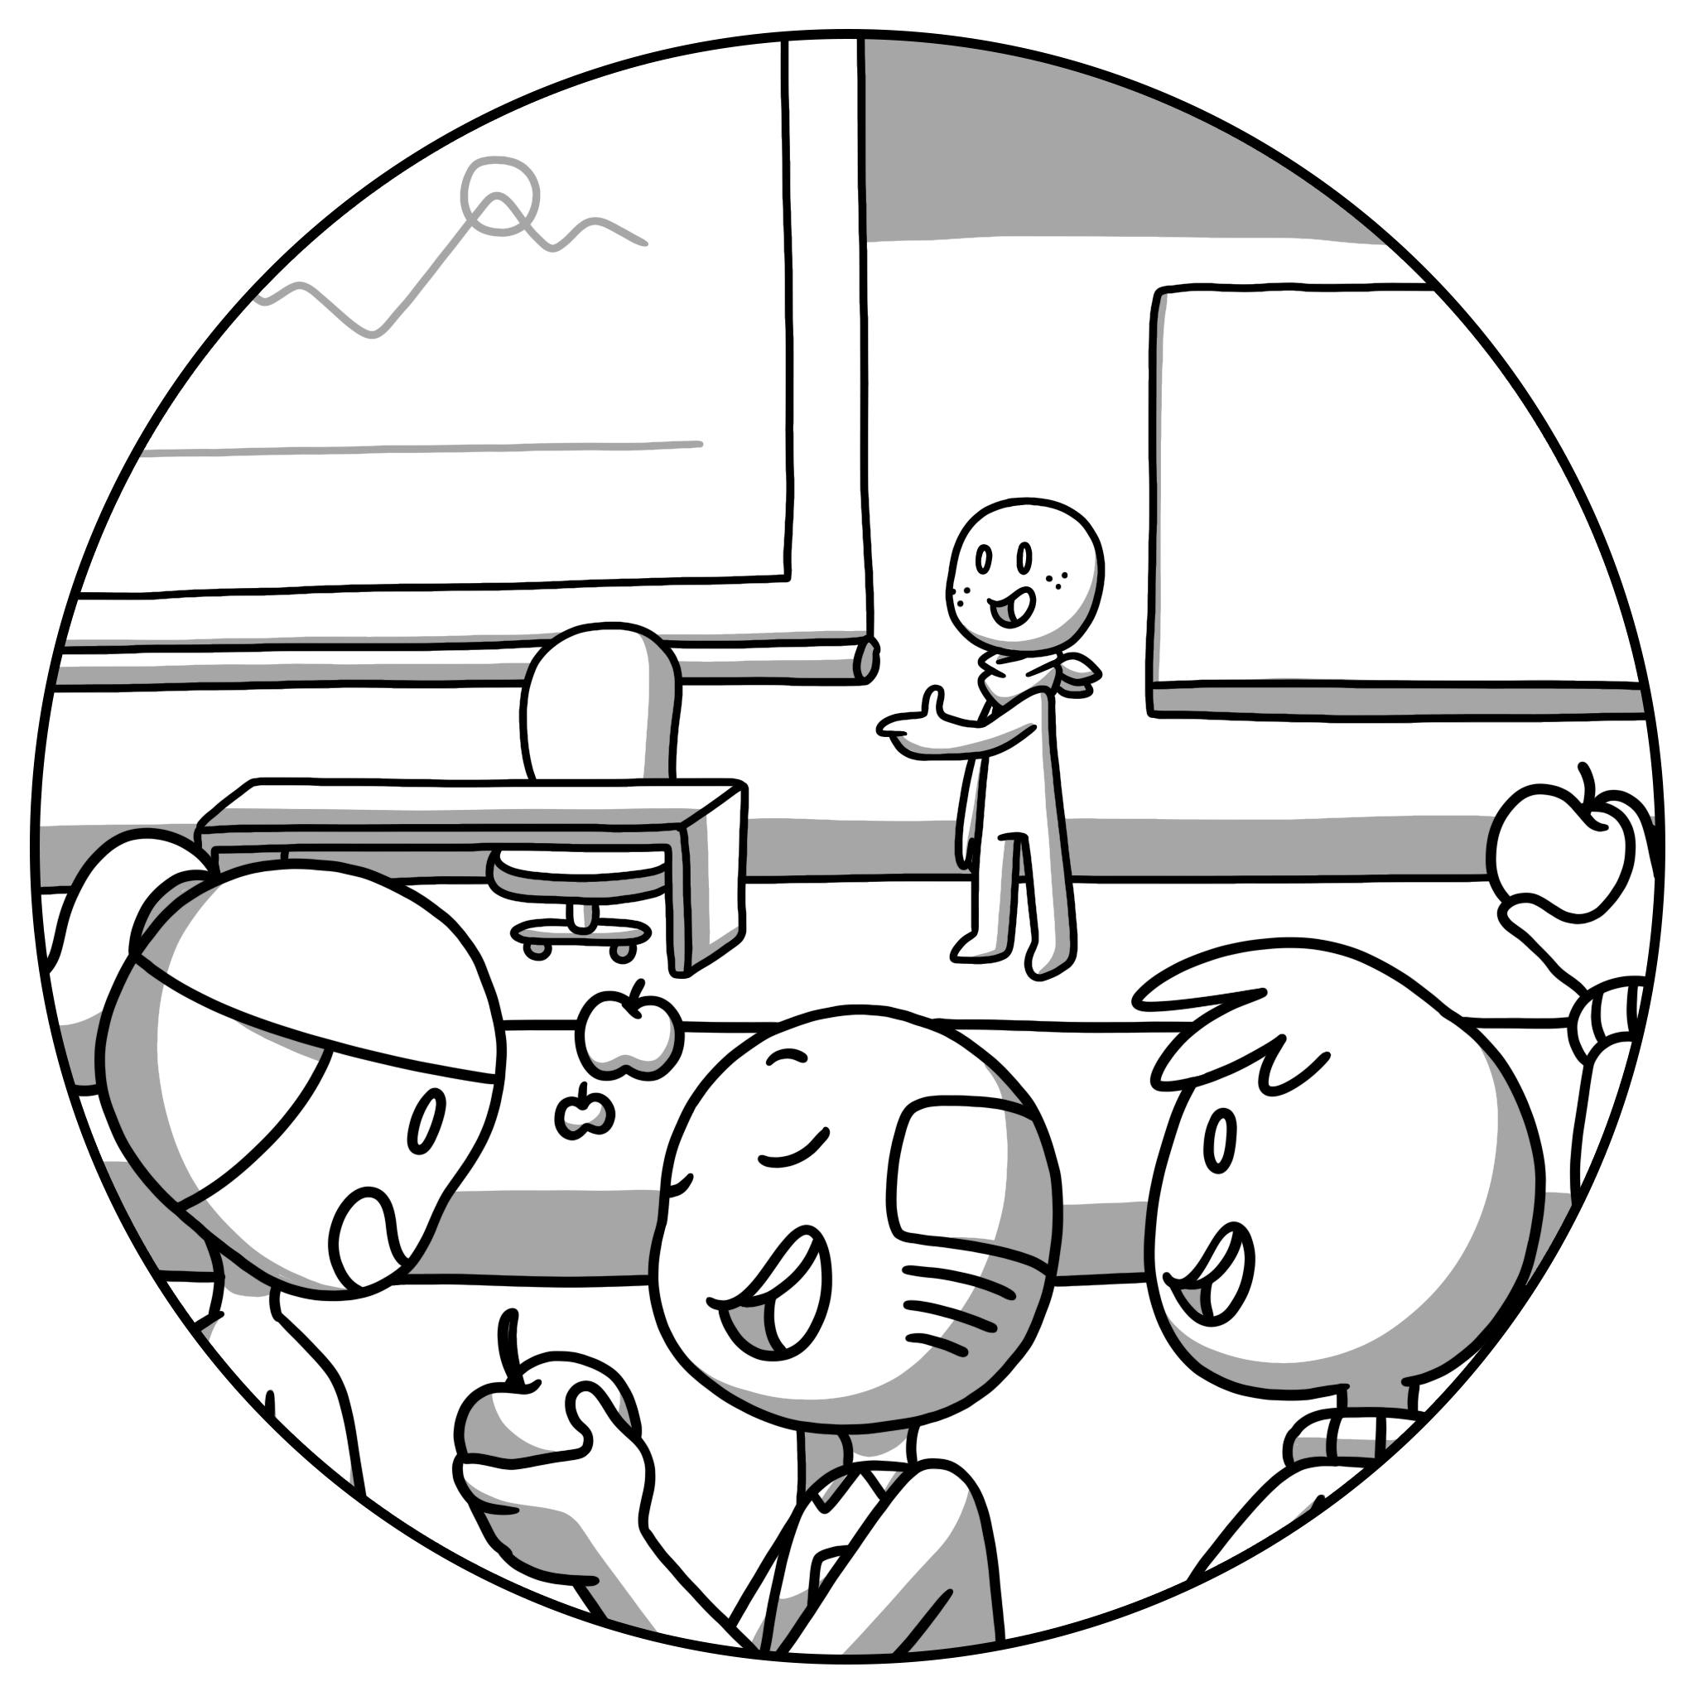
Central
Tendency

Slide 2


This comic was created in the course of the research project Comixplain, funded by St. Pölten UAS in the course of the Innovation Call 2022.
Project Team:
Victor-Adriel De-Jesus-Oliveira
Hsiang-Yun Wu
Christina Stoiber
Magdalena Boucher
Alena Ertl
Contact:
victor.oliveira@fhstp.ac.at
Illustrations: Magdalena Boucher & Alena Ertl
https://fhstp.github.io/comixplain

Slide 3
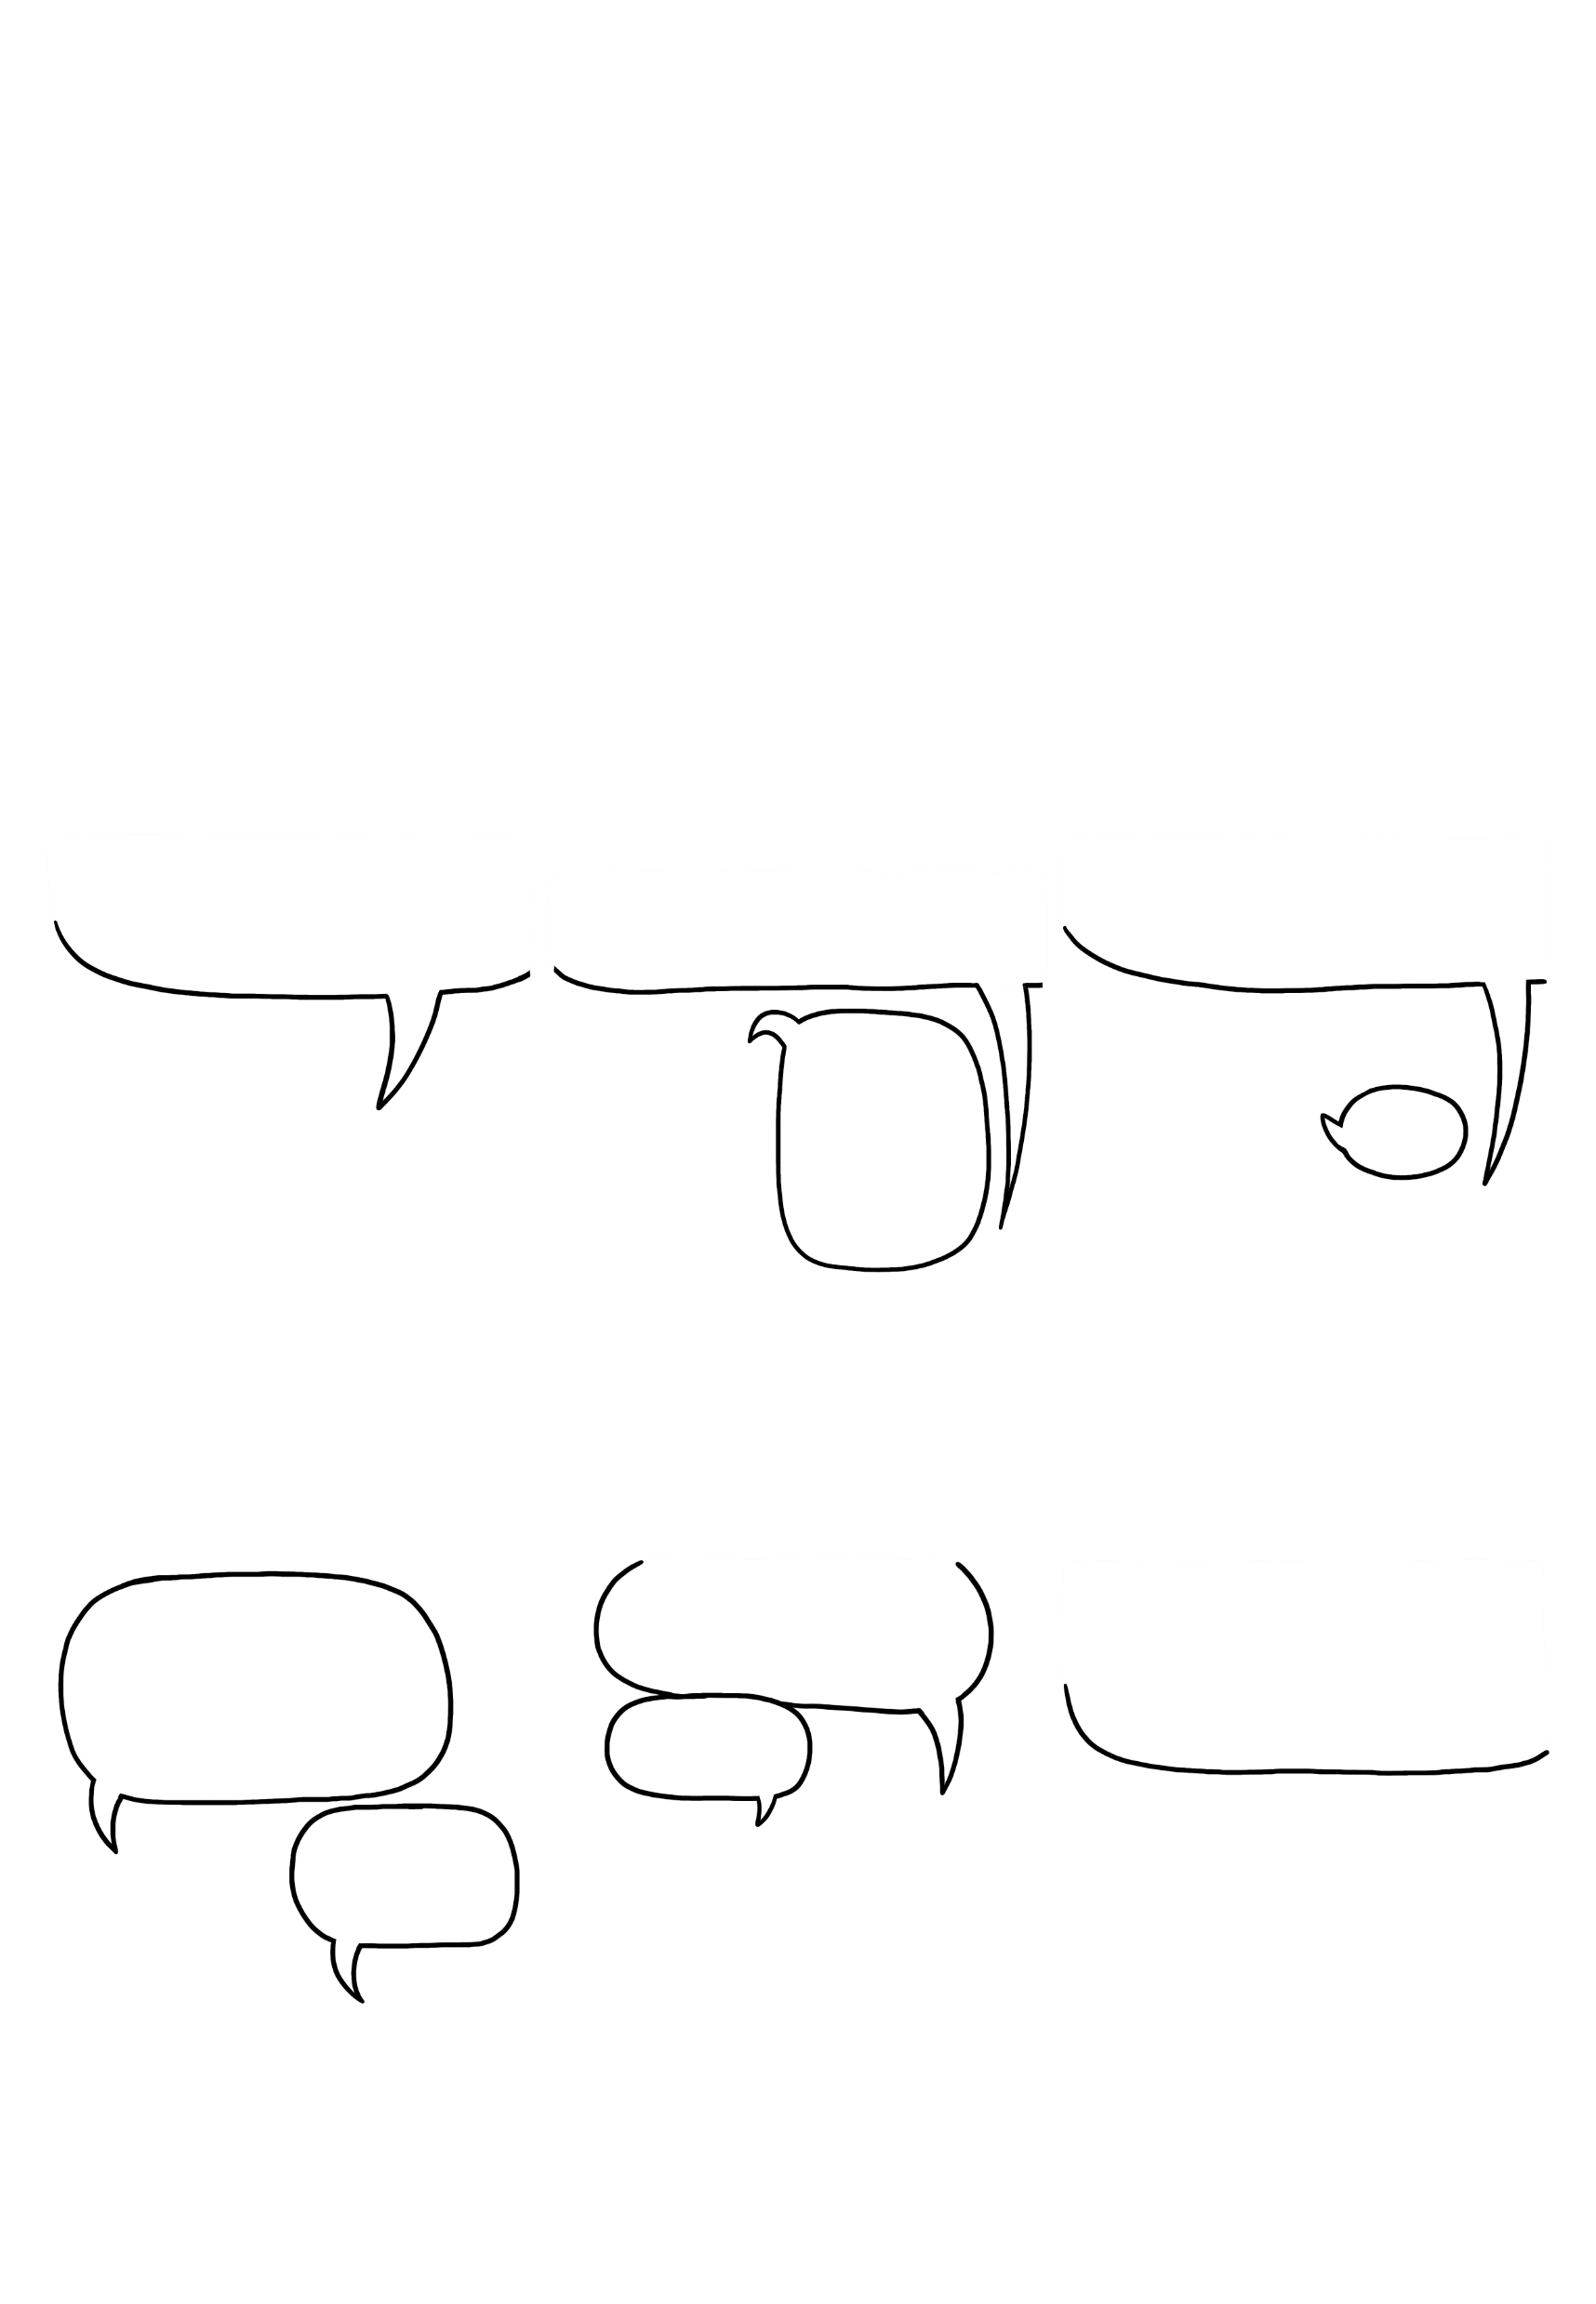
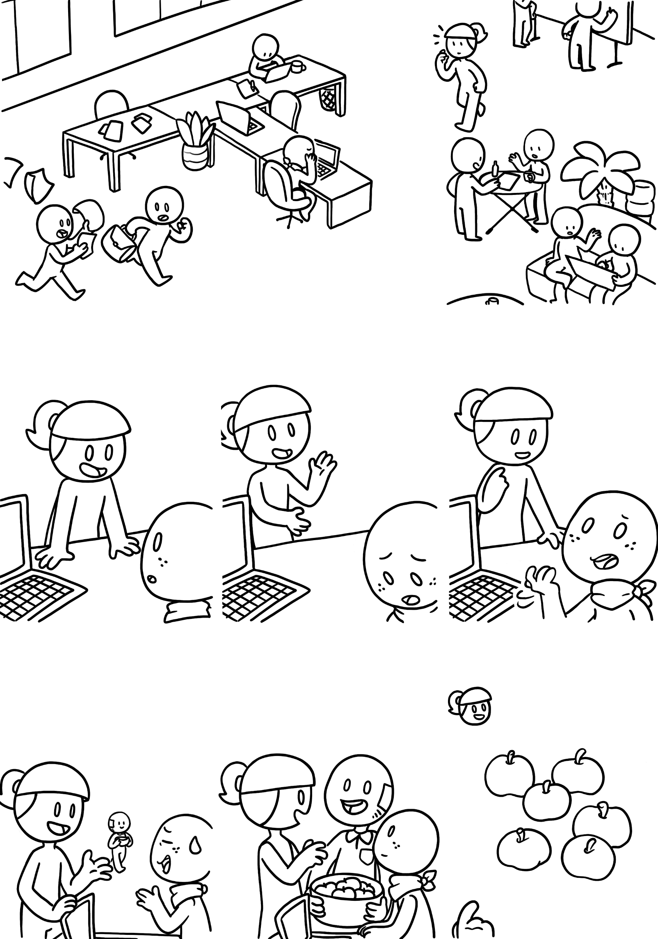


Central Tendency
It‘s a busy day at the
central office…
*sigh*
Hey newbie, are you ready for your presentation today?
Not really… I collected a lot of data, but I only have a few minutes to present everything!
But there are so many interesting aspects! I just don‘t know what to focus on…
Why don‘t you just show the most interesting aspects?
well…
You could start with the CENTRAL TENDENCY. It‘s a good way to get an overview of your data.
Hey, anybody want
some apples?
Okay, see these apples? Let‘s say we measured their weight. The weight is our variable, and we have
different values.
Oh yes, these will do!
Uhh… can you explain that?
180g
180g
190g
200g
180g
190g
1

Slide 4
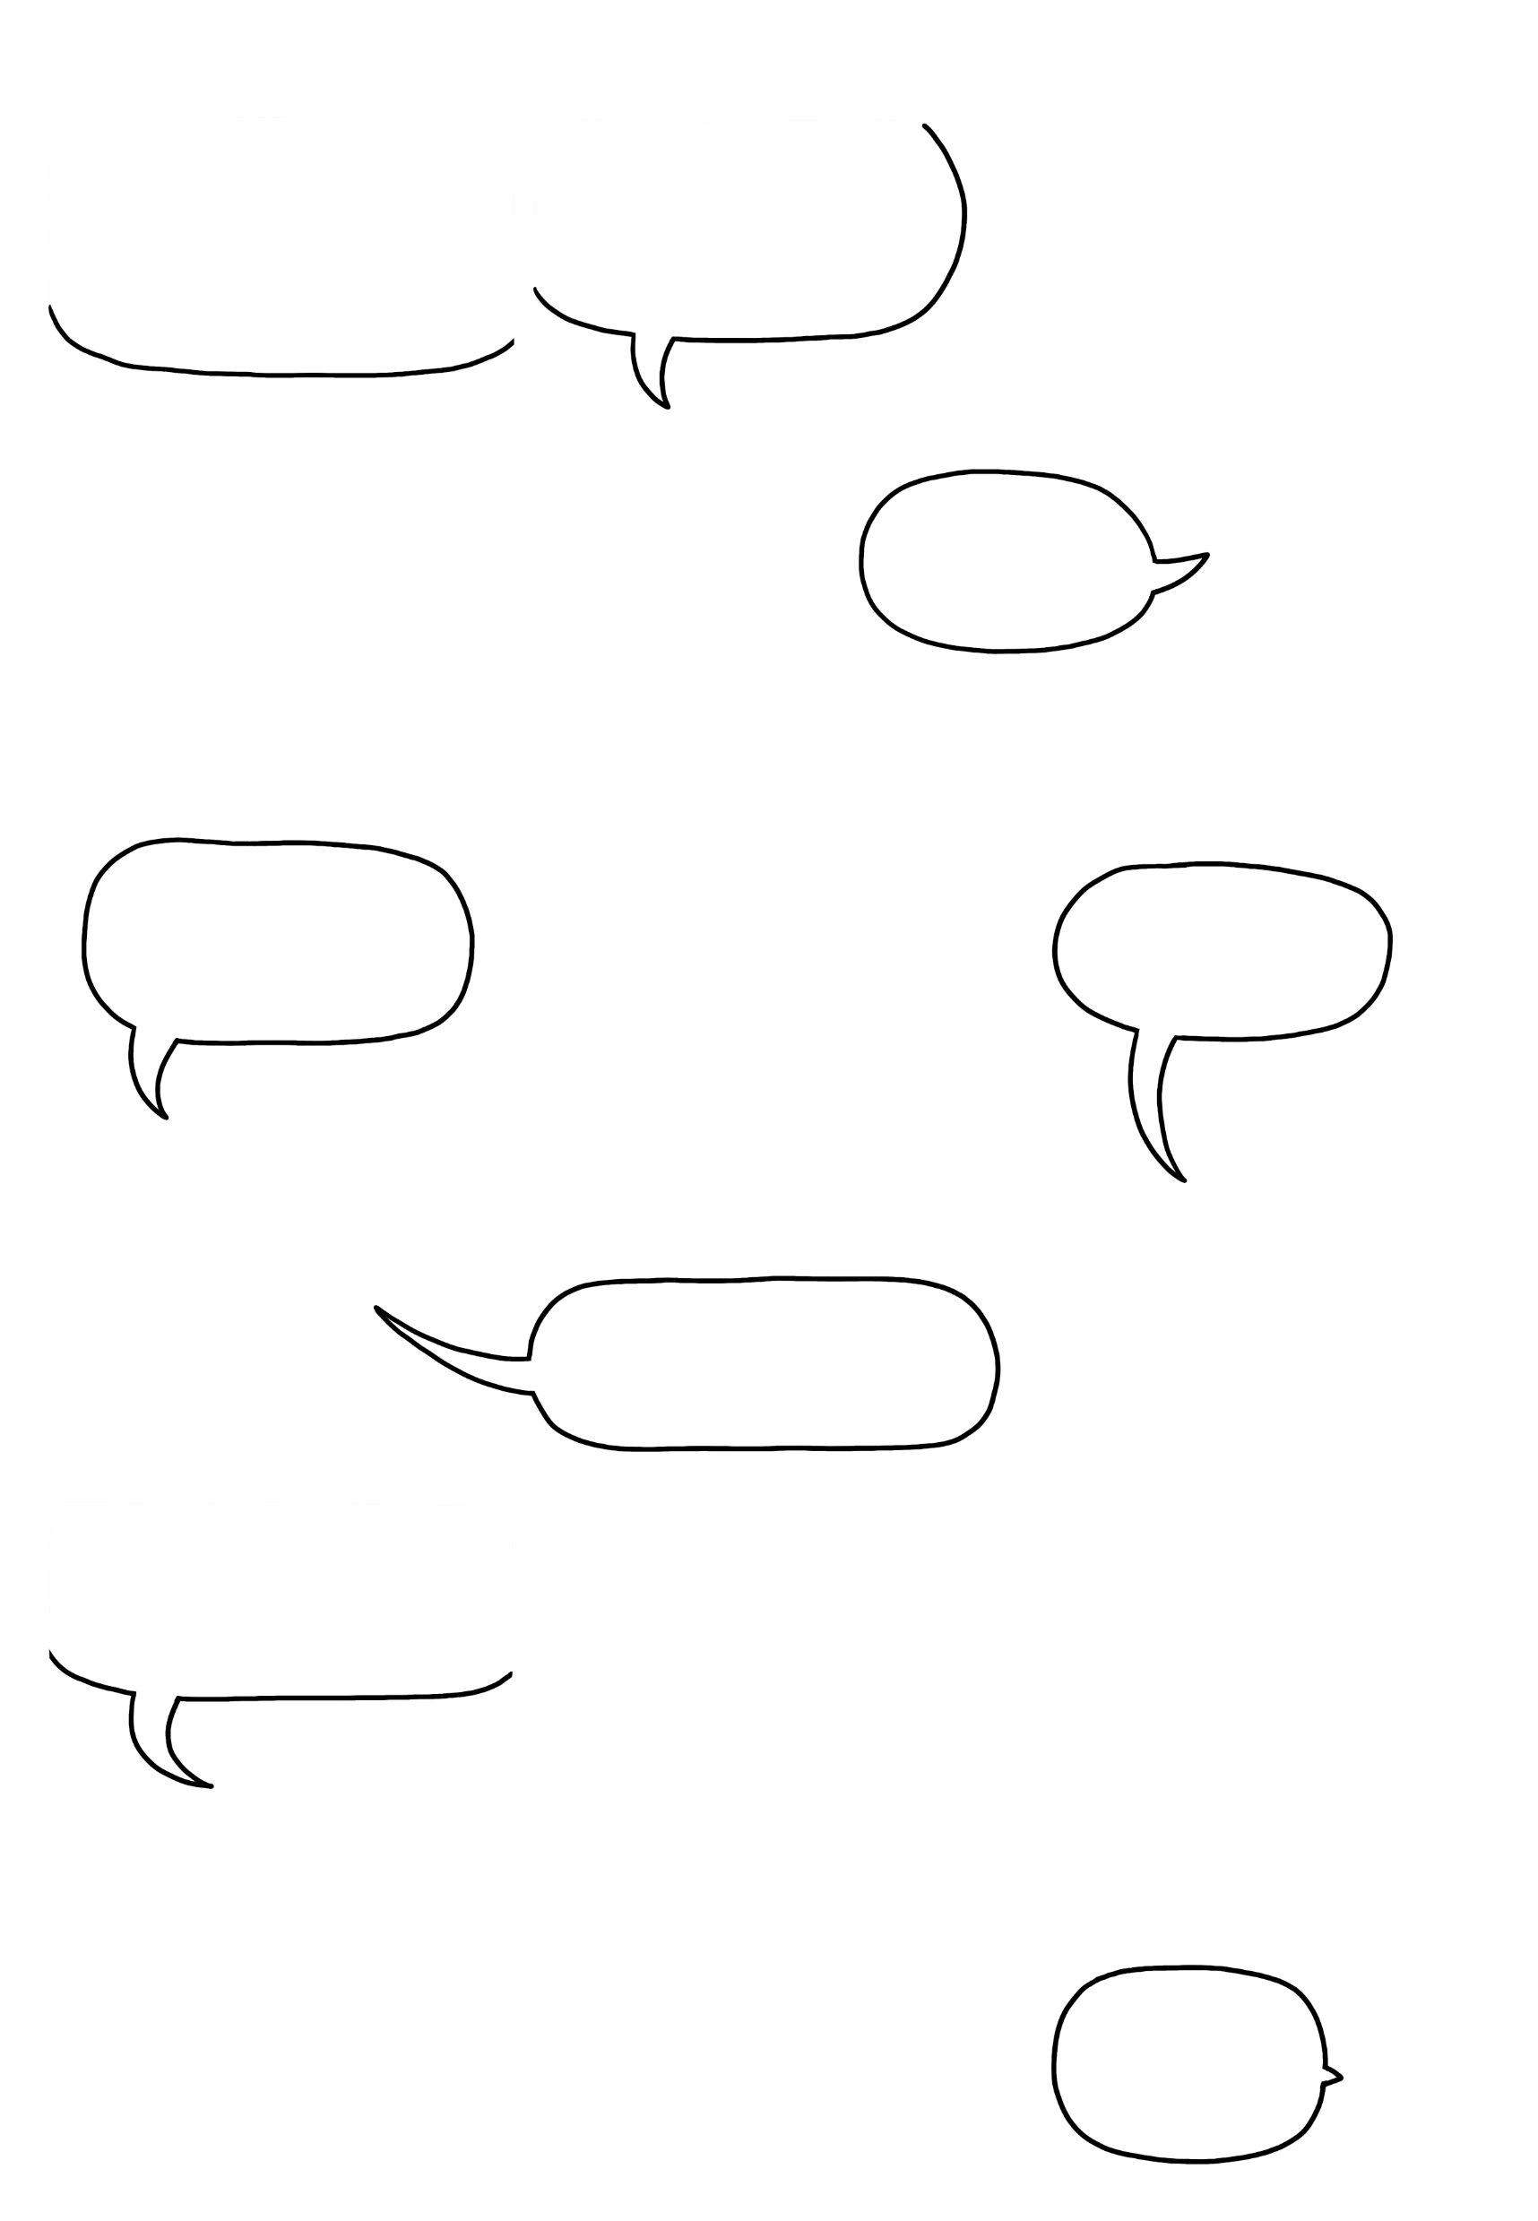
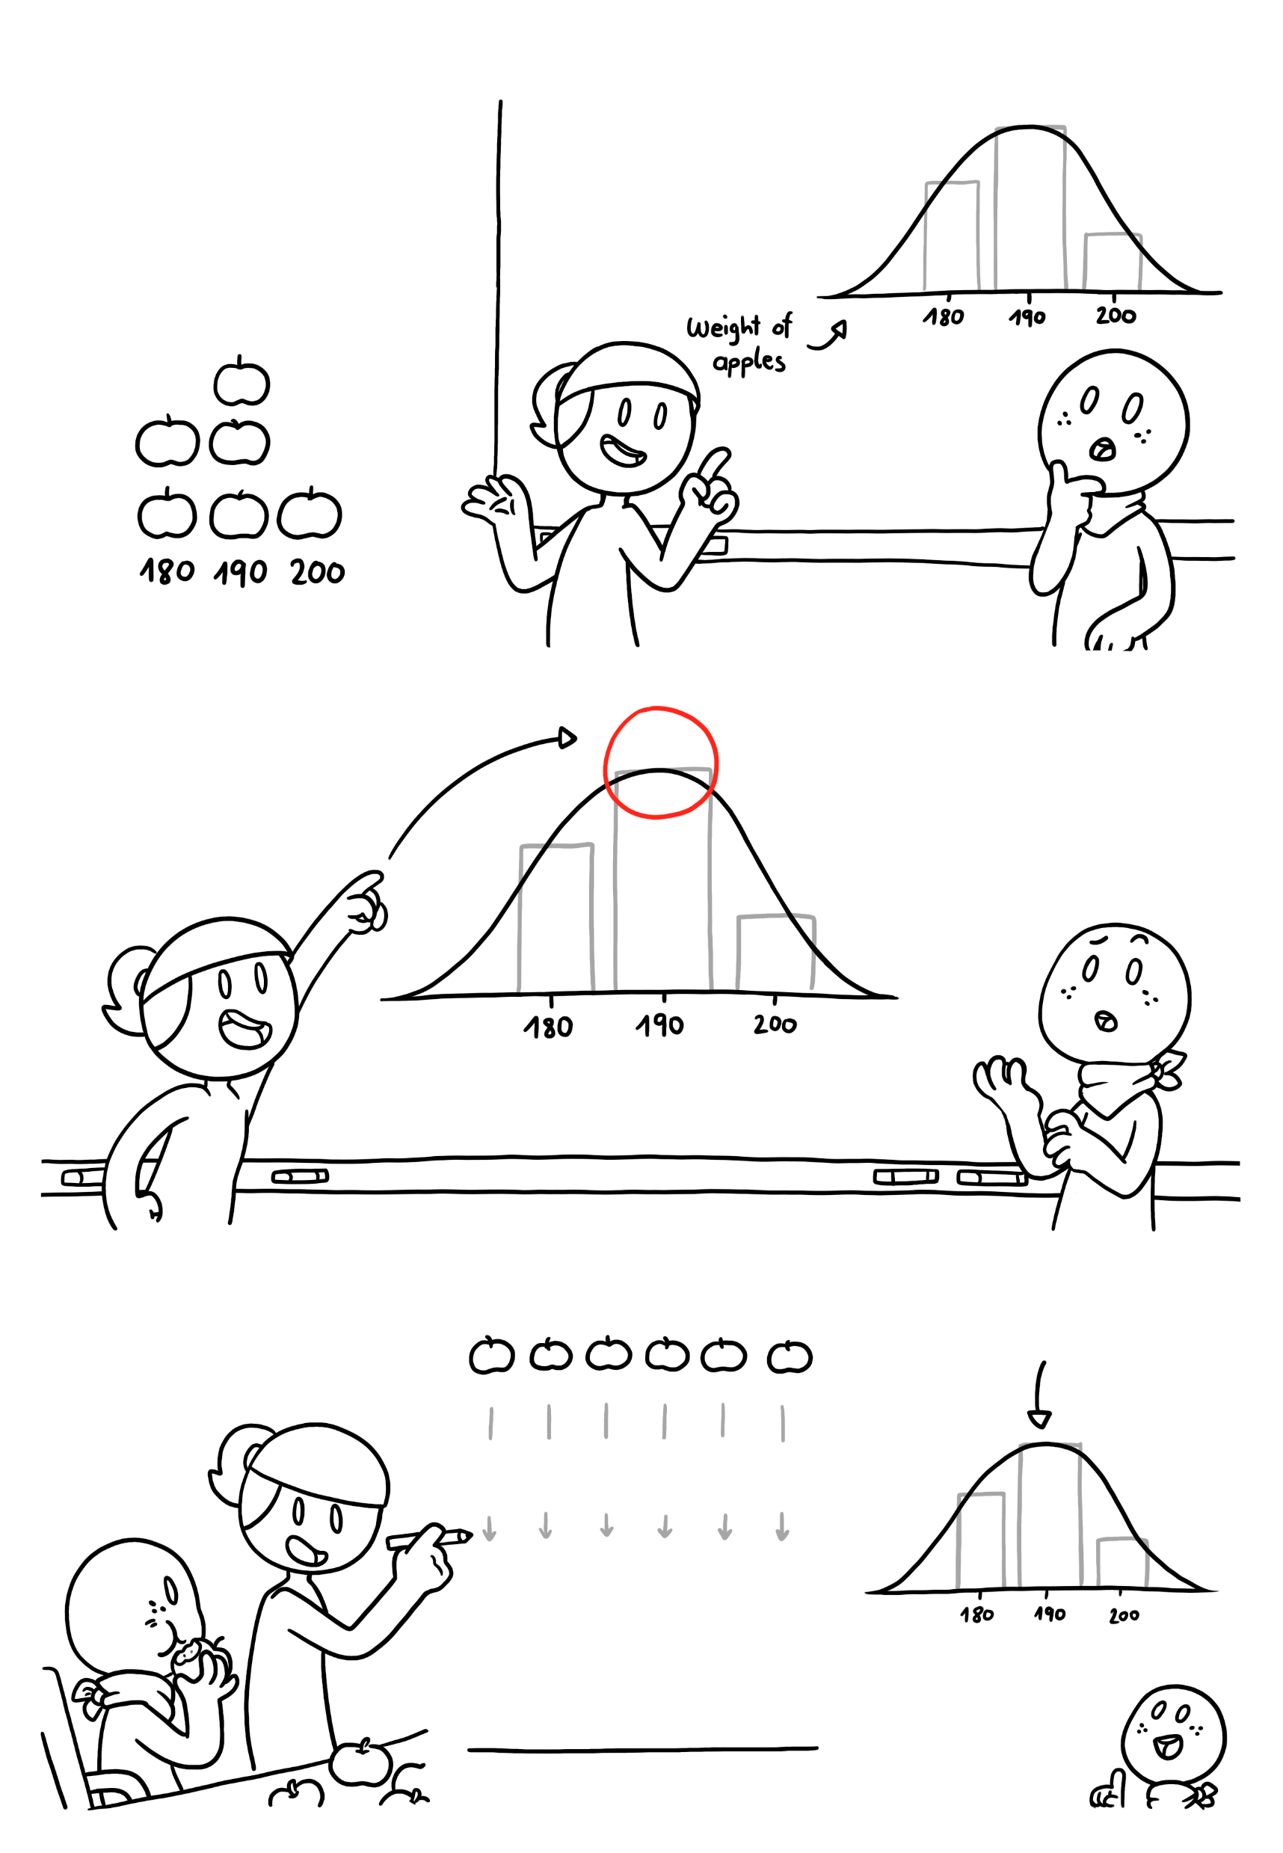



Central Tendency
The best way to describe a variable is to report the values, and how often each value appears. That‘s called the DISTRIBUTION of the variable.
If we visualize the weight of our apples, the distribution would look like this, since all apples in this basket have around the same weight.
It‘s kind of shaped like a bell…
Yes. If there were other apples in the basket, our best guess for their weight would be a value around that same spot.
Ah, okay. But… how would I calculate it?
This central point of our weight distribution represents well our data - that‘s why we call it the CENTRAL TENDENCY.
We can summarize the central tendency in multiple ways. The MEAN value is the most common way, and it‘s easy to calculate, too.
These are our six apples here:
That gives us a mean value of
188.3g
200 180 190 190 190 180
To calculate the mean, we add all the weight values together…
200 + 180 + 190 + 190 + 190 + 180
…and then divide by the number of apples we have…
Oh that‘s really almost the top of our bell-shaped graph!
(200 + 180 + 190 + 190 + 190 + 180)
6
2

Slide 5
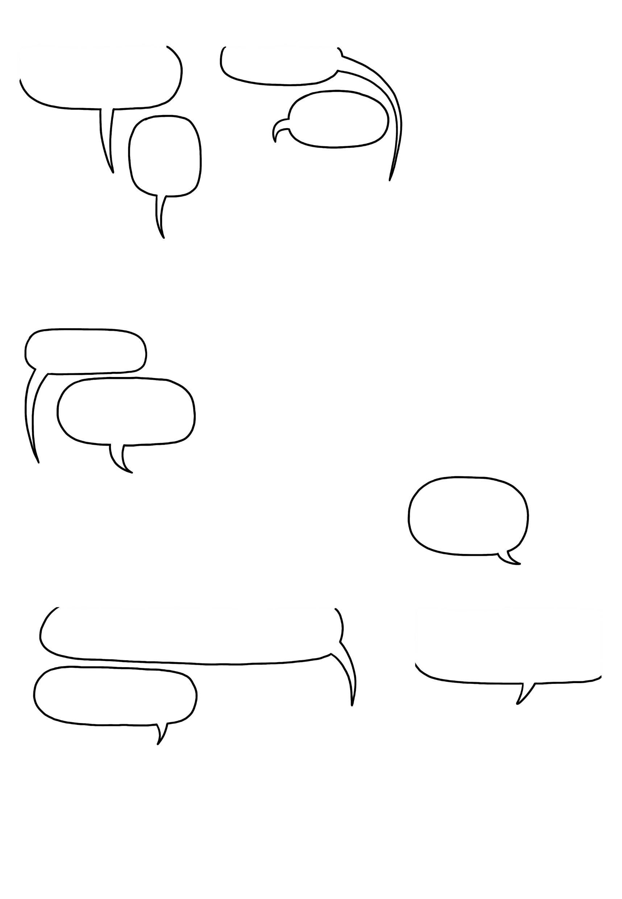
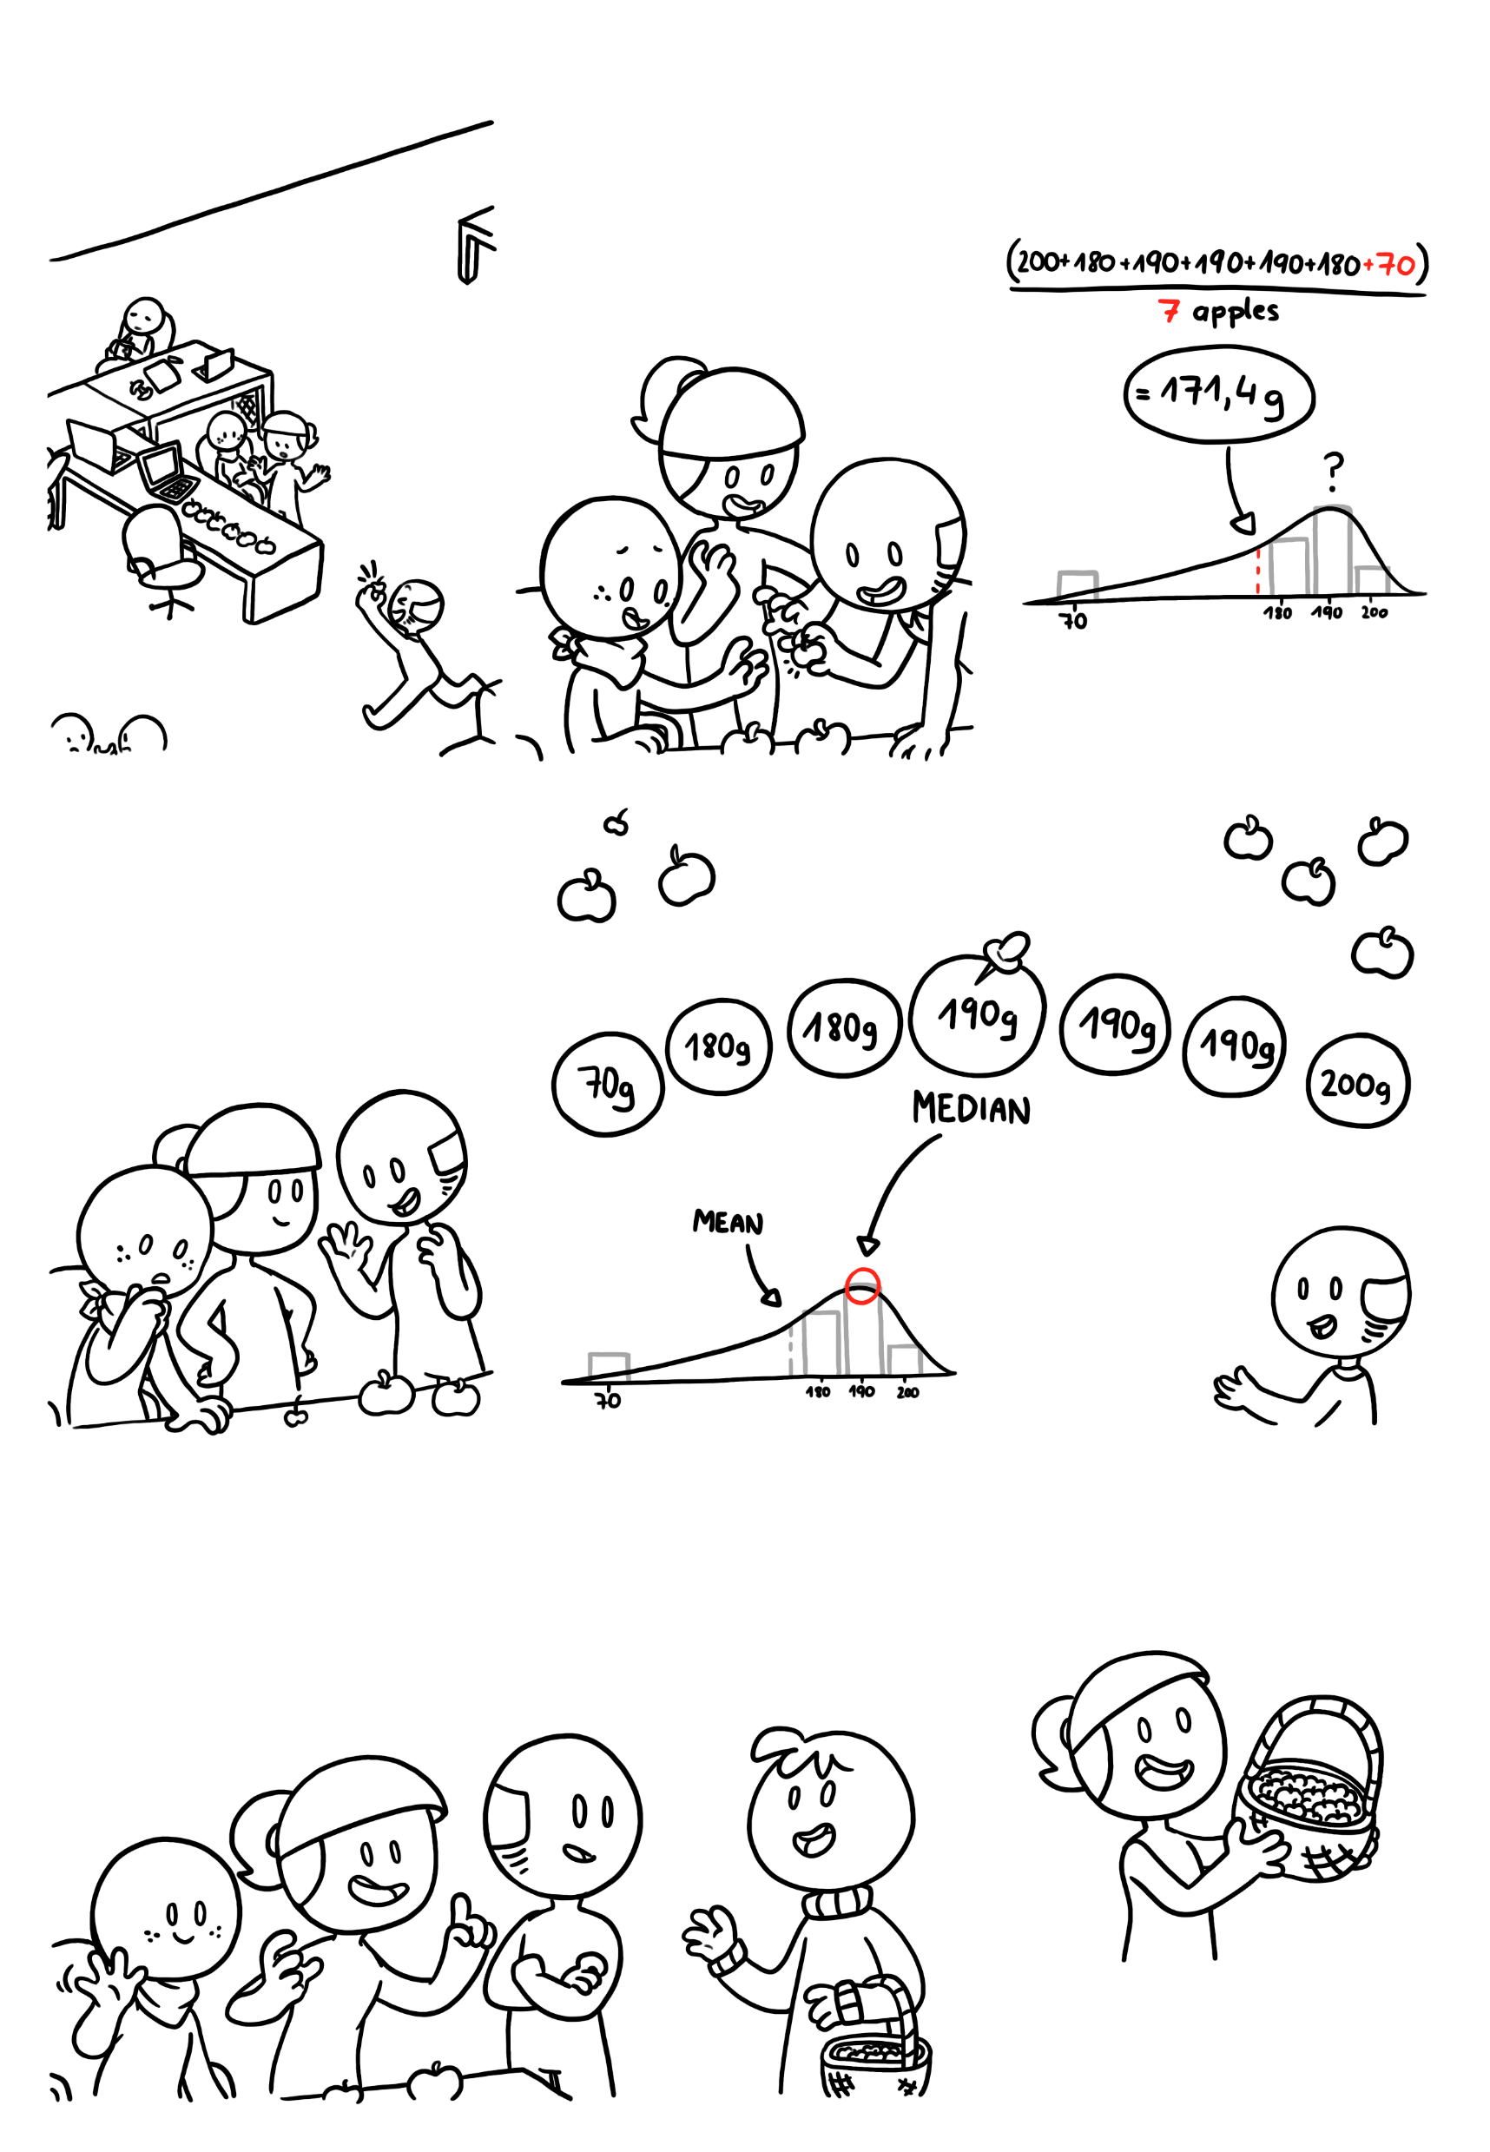

Central Tendency
Exactly. But the mean is not always the best way to describe the data.
It weighs, like, only 70 grams!
If we add the tiny apple to our dataset and calculate the mean…
Guys, you won‘t believe how tiny this apple is!
Once again, perfect example!
.
.
…the graph now looks more like a rat , and the mean is far away from the top, and closer to the tail.
Huh, you‘re right. Now the mean is not very representative…
If we order all our apples by ascending weight, the median is the middle value.
True. But you can still describe the central tendency through the MEDIAN.
The median here is 190g, which better summarizes this skewed distribution.
I see you found my tiny apples. Please help yourselves, I‘m glad people like them!
There is one more thing to explain: If we add this whole basket of tiny apples to our set, the first tiny apple is not an outlier* anymore.
Actually, can we borrow that basket for a moment?
* Outliers are extreme values that can be errors in measurement, or accurate reports of rare events.
3

Slide 6
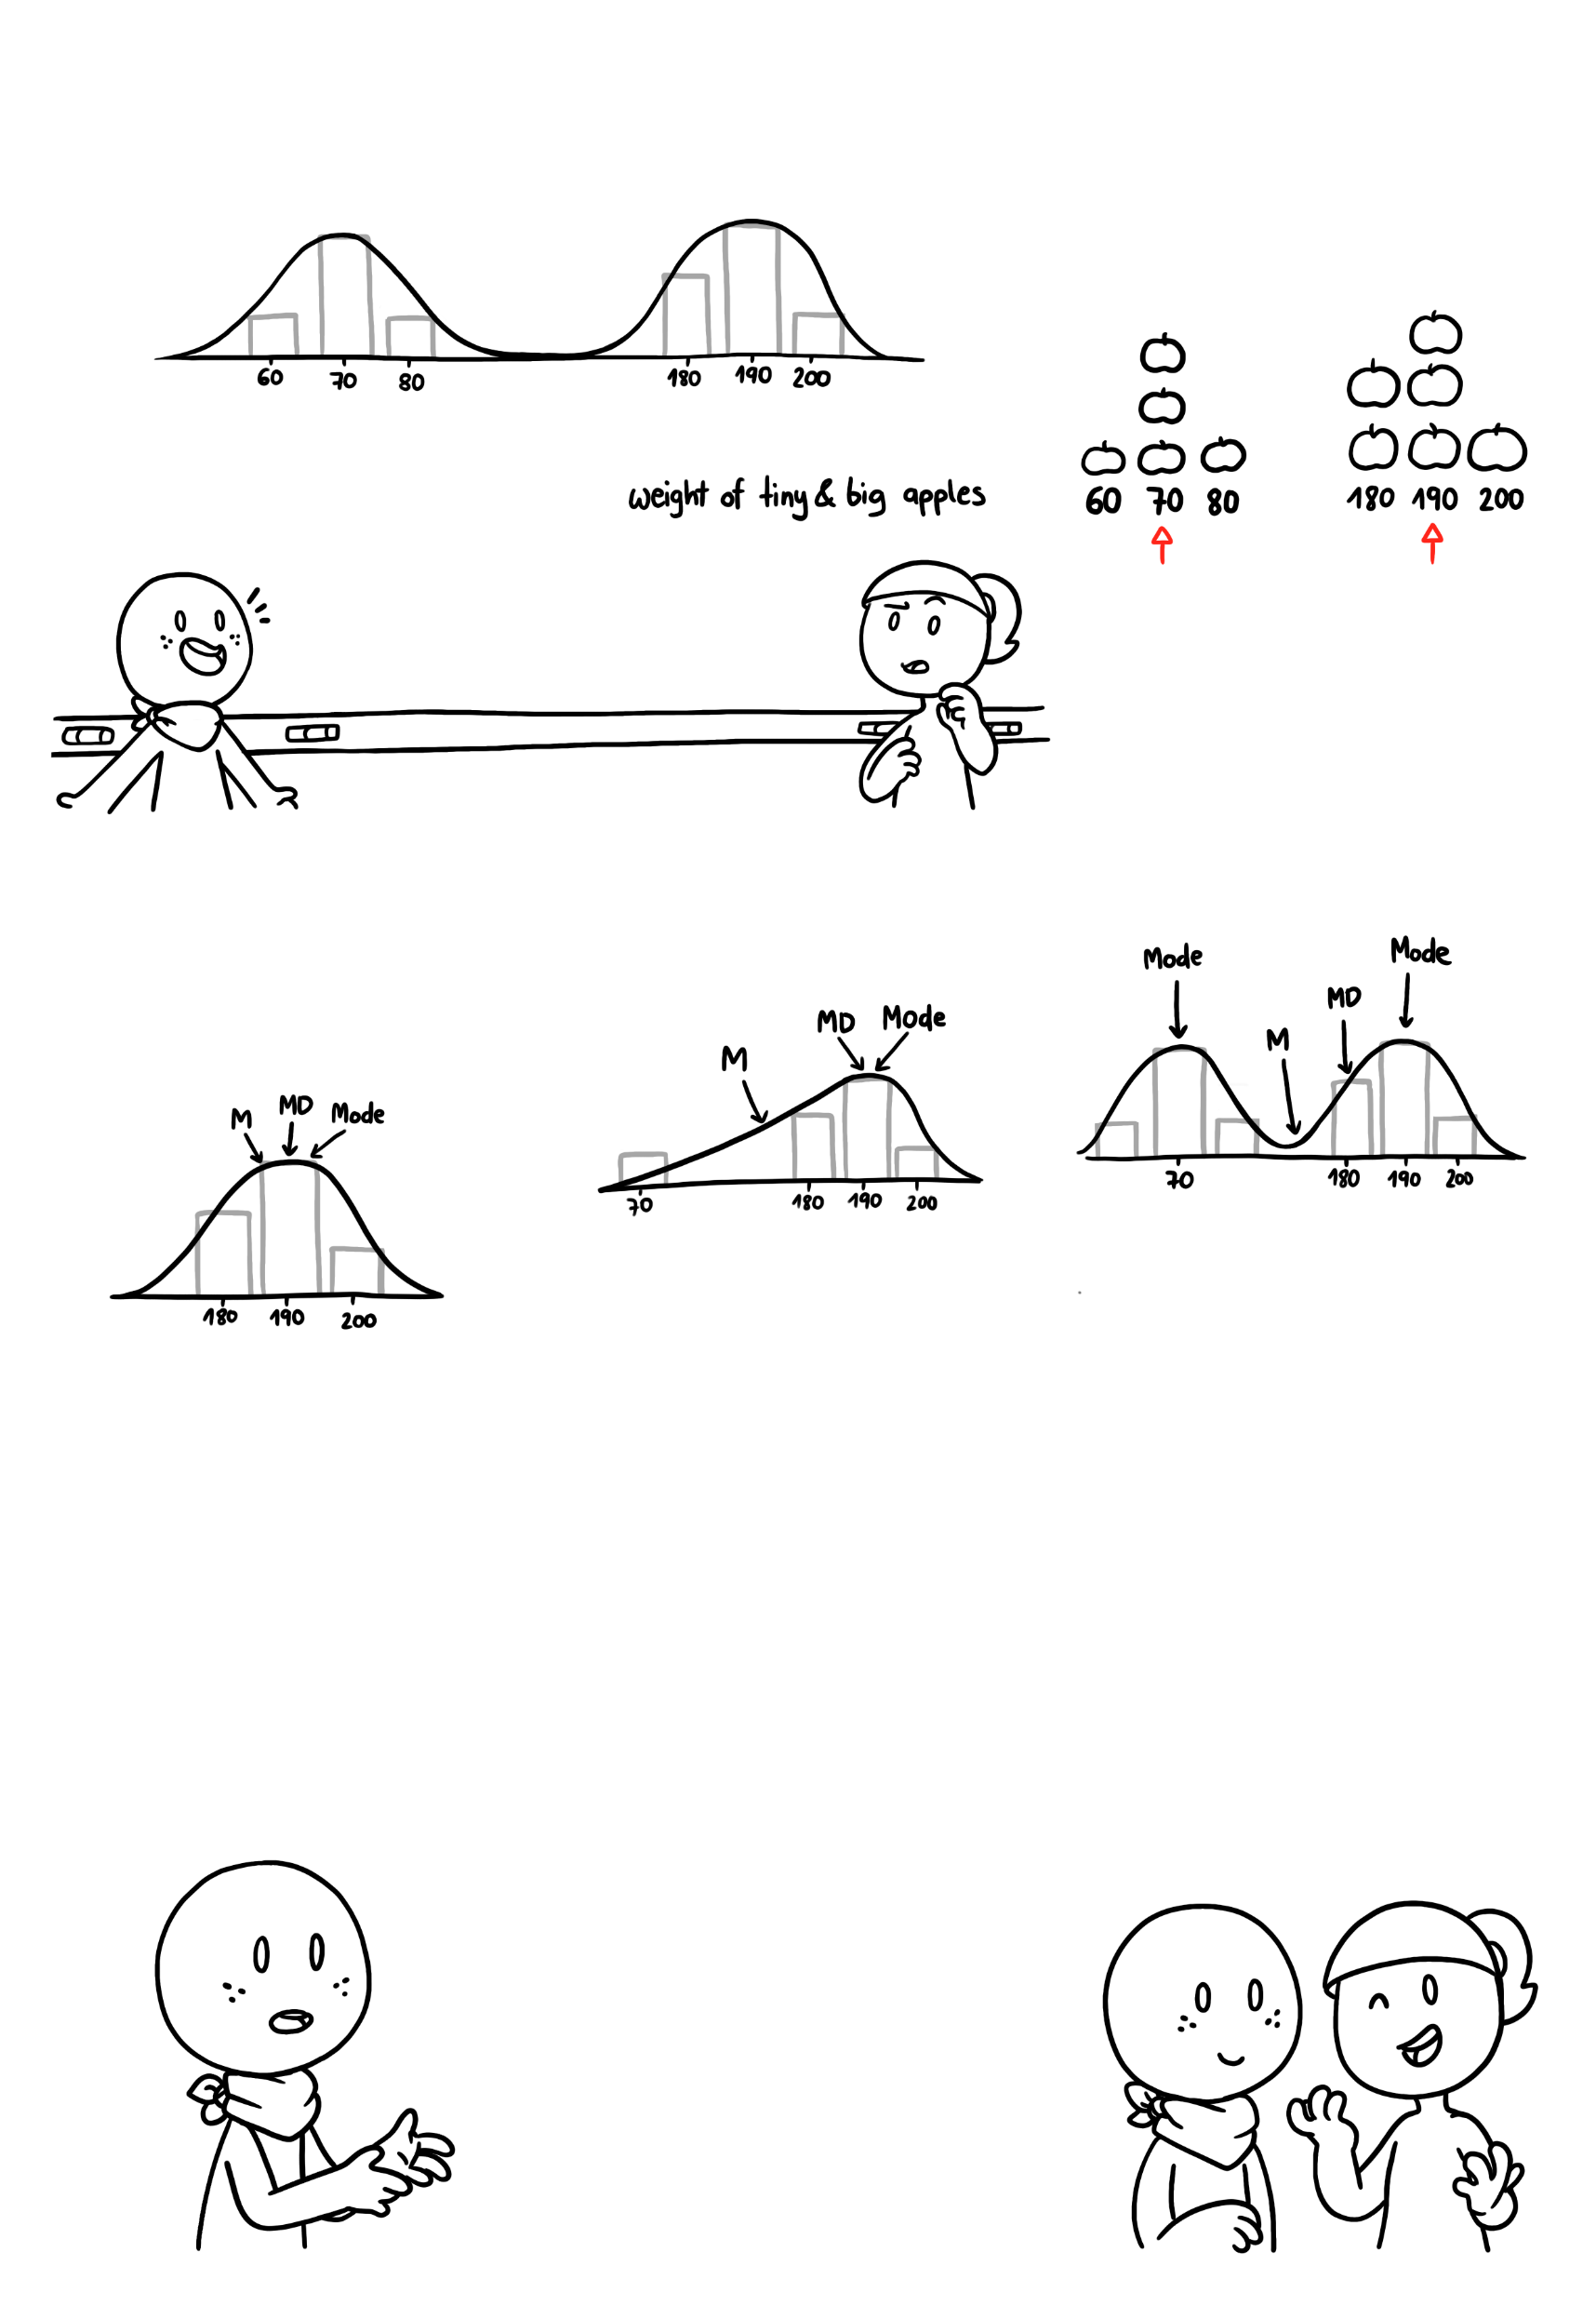
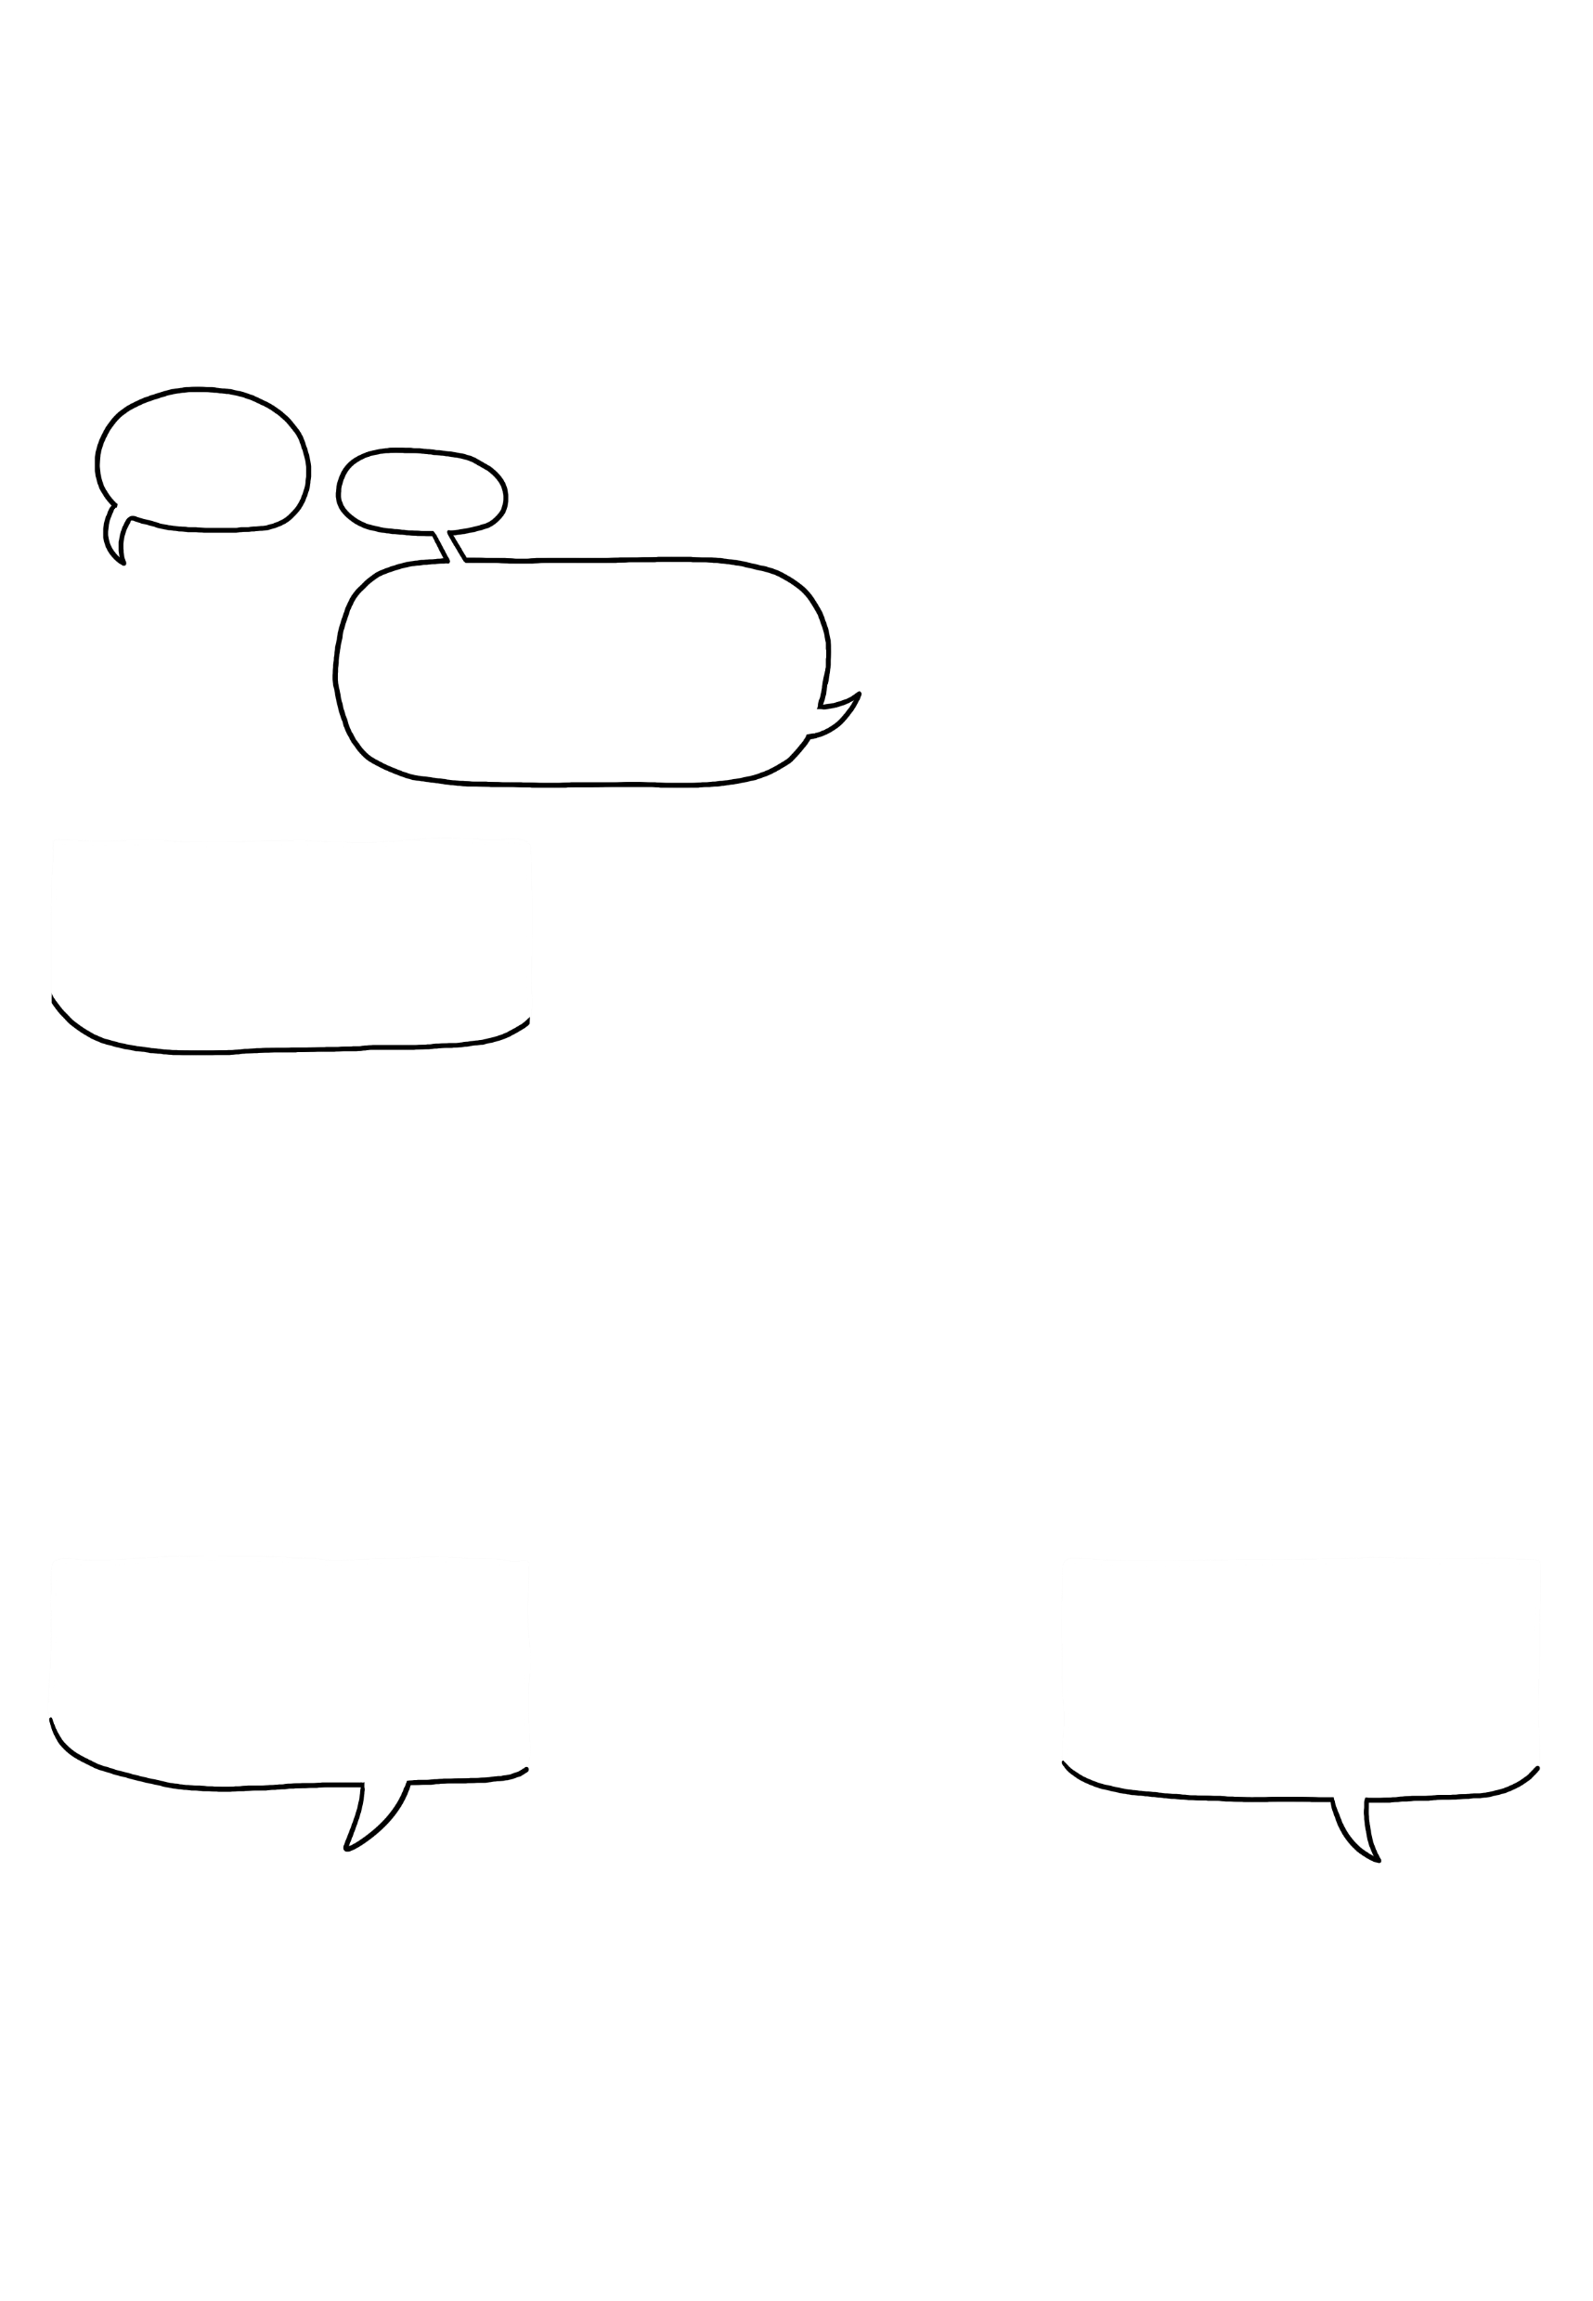






Central Tendency
In this case, our graph suddenly has two hills:
The mode defines the most frequently occuring value(s) in a dataset.
Like two rats in love!
Uhh, sure…
Anyway, we can use something called MODE to describe the central tendency if our distribution has multiple hills.
In this case, we have multiple modes, but there can also be just one, or even no mode at all.
You can apply mean, median, and mode to different samples of apples. But often, some will represent the data better than others.
180, 180, 190, 190, 190, 200
70, 180 ,181, 190, 191, 191, 200
60, 70, 70, 70, 80, 180, 180, 190, 190, 190, 200
M = 188.3
MD = 190 Mode = 190
good parameters
M = 171.8
MD = 190 Mode = 191
good parameters
M = 134.5
MD = 180 Mode = 70 & 190
good parameter
Okay, thank you… I‘ve learned a lot. Now I just have to apply this to the data I have to present. It‘s from an app that tracks heart rate measurements.
User ID
Heart Rate (bpm)
Time of Use
User Rating
That should be doable - take a look at your data and follow the same steps we just did with the apples! You can use the next page for your calculations.
1
45
13:00
1
2
50
9:00
5
3
55
10:00
3
4
57
9:00
4
5
63
14:00
5
6
70
15:00
5
7
65
16:00
4
8
75
15:00
2
4

Slide 7

Central Tendency
Before turning the page, try to calculate mean, median and mode for each variable, and check which parameter is most adequate for describing the central tendency. You can take notes on this page!
5

Slide 8
Central Tendency
Feel free to check the calculations. You can take further notes on this page!
6

Slide 9
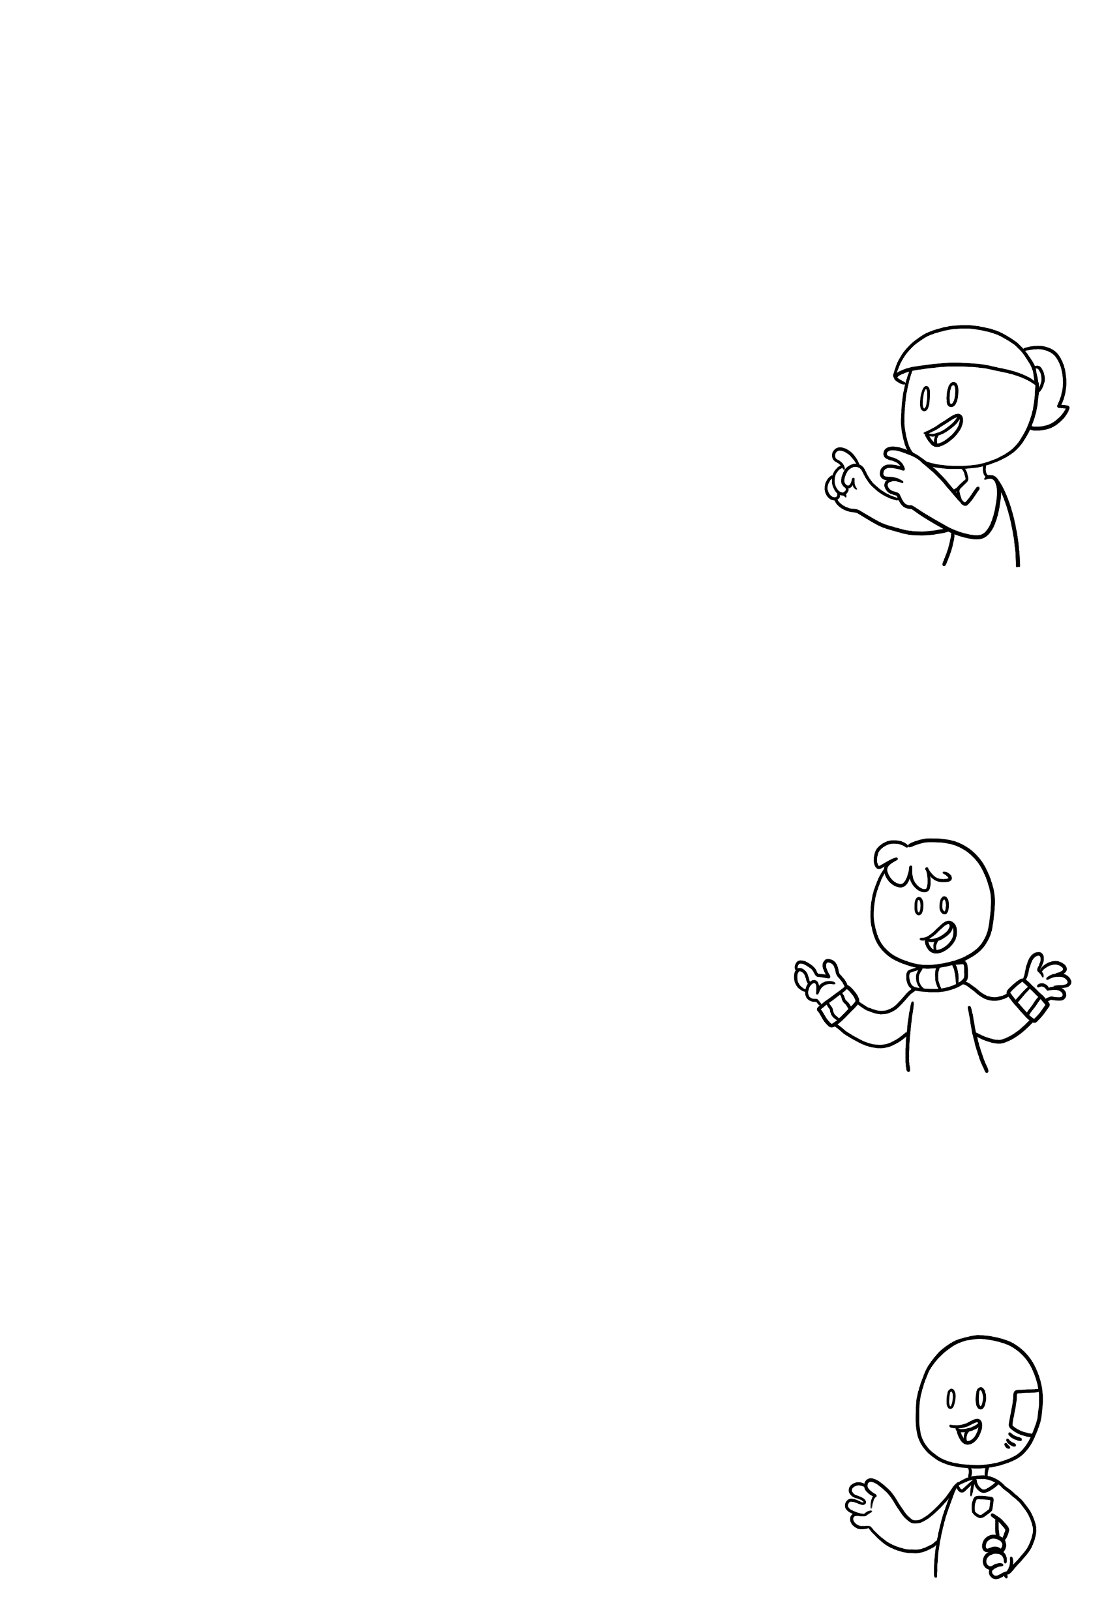
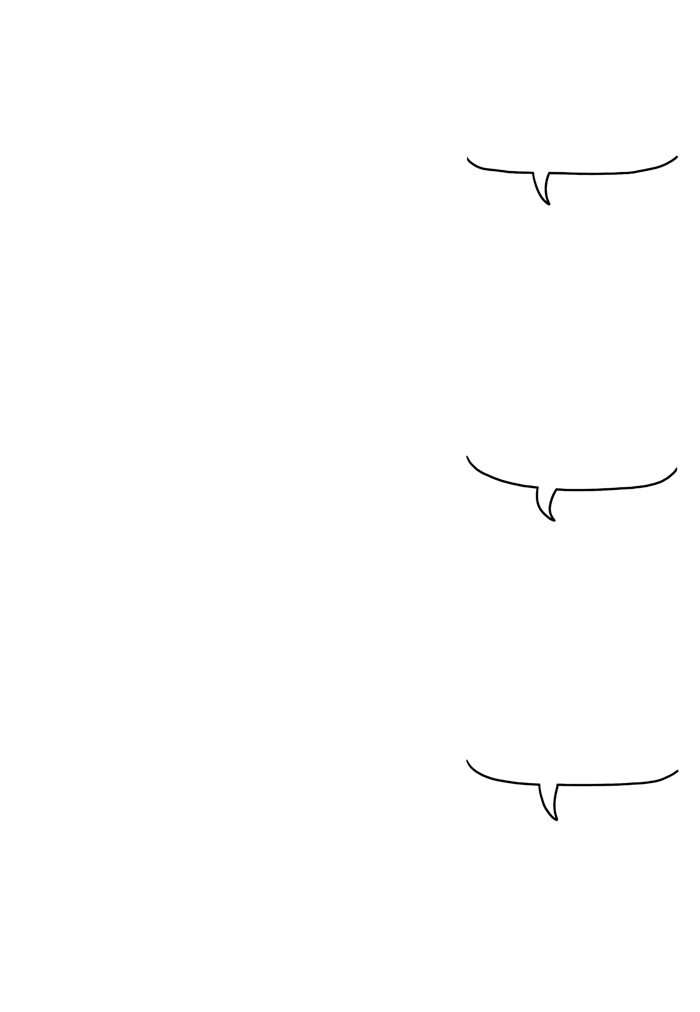
Central Tendency
HEART RATE
If the distribution of the values is symmetrical, without any distortions, the mean is equal to the median.
Calculating the MEAN:
45+50+55+57+63+70+65+75
480
60 bpm
8 users
=
8
=
Calculating the MEDIAN:
45
50
55
57
63
65
70
75
If there are two central values, the mean of the two values is the median: (57+63)/2 = 60bpm)
Calculating the MODE:
45, 50, 55, 57, 63, 70, 65, 75
Each value only exists once - there is no mode!
MOST FREQUENT TIME OF USE
Mode is not only suited for multimodal distributions, but also when working with ordinal and categorical data.
Calculating the MEAN:
9+9+10+13+14+15+15+16
=
101
=
12.6?
8 users
8
Time of use is not a quantitative value - so calculating mean and median does not make any sense!
Calculating the MEDIAN:
9
9
10
13
14
15
15
16
=
13.5?
Calculating the MODE:
9:00, 10:00, 13:00, 14:00, 15:00, 16:00
=
2 modes:
2x 1x 1x 1x 2x 1x
9:00 & 15:00
STAR RATING
For datasets with a skewed distribution, the median is a better way to describe central tendency.
Calculating the MEAN:
1+2+3+4+4+5+5+5
=
29
=
3.6 stars
8 users
8
Calculating the MEDIAN:
1
2
3
4
4
5
5
5
=
4 stars
Calculating the MODE:
1 2 3 4 5
5 stars
=
1x 1x 1x 2x 3x
7

Slide 10
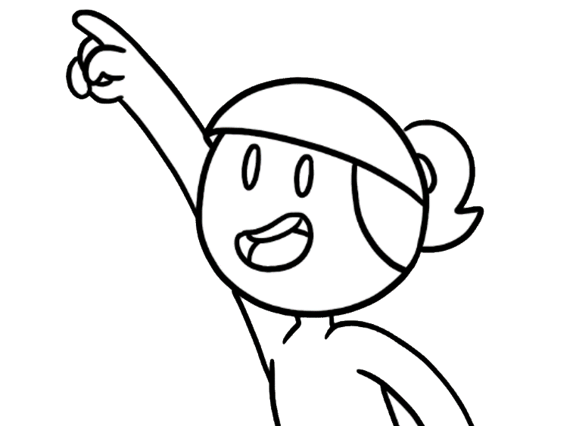
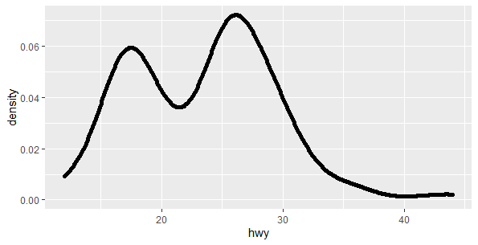
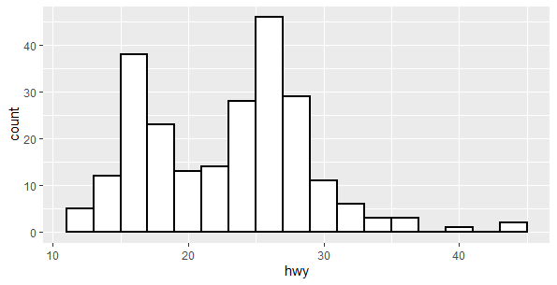
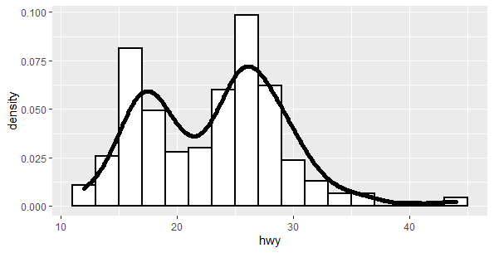
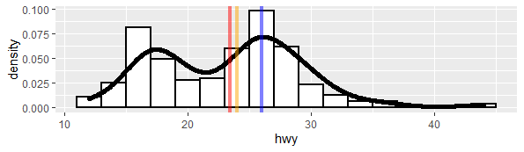
Central Tendency
Programming languages like R, can help you calculate the central tendency of attributes in large datasets. With R libraries, like tidyverse, you can quickly visualize the data distribution.
model
year
hwy
In tidyverse, you have access to datasets such as mpg with fuel economy data. It includes 11 attributes, such as car model, year of manufacture, and highway miles per gallon (hwy).
1
jetta
1999
44
2
corolla
2008
37
3
civic
2008
36
4
civic
2008
36
5
corolla
1999
35
6
altima
2008
32
7
sonata
2008
31
+ other 227 entries
You can use ggplot, which is included in tidyverse, to visualize the data distribution of highway miles per gallon (hwy) using a histogram, a density curve, or both.
install.packages("tidyverse")
library(tidyverse)
plot <- ggplot(mpg, aes(x=hwy))
# Install it only the first time using the library
plot +
geom_histogram(
colour="black",
fill="white“ )
plot +
geom_histogram(aes(y=..density..),
colour="black",
fill="white" ) +
geom_density()
plot +
geom_density()
= 23.4
R includes native functions to calculate mean and median. For mode, you can build your own function or use the Most Likely Values (mlv) from the library modeest.
mean(mpg$hwy)
median(mpg$hwy)
library(modeest)
mlv(mpg$hwy)
= 24
= 26
M
Md
Mode
8

Slide 11
Sources:
Downey, A. (2014). Think stats: exploratory data analysis. O'Reilly Media, Inc.
Field, A. (2022). An adventure in statistics: The reality enigma. Sage.
Central Tendency © 2022 by Comixplain Team: Victor-Adriel De-Jesus-Oliveira, Hsiang-Yun Wu, Christina Stoiber, Magdalena Boucher, and Alena Ertl, with illustrations by Magdalena Boucher and Alena Ertl, all employed by Sankt Pölten University of Applied Sciences is licensed under CC BY-SA 4.0. To view a copy of this license, visit http://creativecommons.org/licenses/by-sa/4.0/

Slide 12
Reporting Data
BCC - 3 - Usability and Experience Evaluation - EMH-UEE

Slide 13
This comic was created in the course of the research project Comixplain, funded by St. Pölten UAS in the course of the Innovation Call 2022.
Project Team:
Victor-Adriel De-Jesus-Oliveira
Hsiang-Yun Wu
Christina Stoiber
Magdalena Boucher
Alena Ertl
Contact:
victor.oliveira@fhstp.ac.at
Illustrations: Magdalena Boucher & Alena Ertl

Slide 14
Reporting Data
It‘s a busy day at the
central office…
*sigh*
Hey newbie, are you ready for your presentation today?
Not really… I collected a lot of data, but I only have a few minutes to present everything!
But there are so many interesting aspects! I just don‘t know what to focus on…
Why don‘t you just show the most interesting aspects?
well…
You could start with the CENTRAL TENDENCY. It‘s a good way to get an overview of your data.
Hey, anybody want
some apples?
Okay, see these apples? Let‘s say we measured their weight. The weight is our variable, and we have
different values.
Oh yes, these will do!
Uhh… can you explain that?
180g
180g
190g
200g
180g
190g

Slide 15
Reporting Data
The best way to describe a variable is to report the values, and how often each value appears. That‘s called the DISTRIBUTION of the variable.
If we visualize the weight of our apples, the distribution would look like this, since all apples in this basket have around the same weight.
It‘s kind of shaped like a bell…
Yes. If there were other apples in the basket, our best guess for their weight would be a value around that same spot.
Ah, okay. But… how would I calculate it?
This central point of our weight distribution represents well our data - that‘s why we call it the CENTRAL TENDENCY.
We can summarize the central tendency in multiple ways. The MEAN value is the most common way, and it‘s easy to calculate, too.
These are our six apples here:
That gives us a mean value of
188.3g
200 180 190 190 190 180
To calculate the mean, we add all the weight values together…
200 + 180 + 190 + 190 + 190 + 180
…and then divide by the number of apples we have…
Oh that‘s really almost the top of our bell-shaped graph!
(200 + 180 + 190 + 190 + 190 + 180)
6

Slide 16
Reporting Data
Exactly. But the mean is not always the best way to describe the data.
It weighs, like, only 70 grams!
If we add the tiny apple to our dataset and calculate the mean…
Guys, you won‘t believe how tiny this apple is!
Once again, perfect example!
.
.
…the graph now looks more like a rat , and the mean is far away from the top, and closer to the tail.
Huh, you‘re right. Now the mean is not very representative…
If we order all our apples by ascending weight, the median is the middle value.
True. But you can still describe the central tendency through the MEDIAN.
The median here is 190g, which better summarizes this skewed distribution.
I see you found my tiny apples. Please help yourselves, I‘m glad people like them!
There is one more thing to explain: If we add this whole basket of tiny apples to our set, the first tiny apple is not an outlier* anymore.
Actually, can we borrow that basket for a moment?
* Outliers are extreme values that can be errors in measurement, or accurate reports of rare events.

Slide 17
Reporting Data
In this case, our graph suddenly has two hills:
The mode defines the most frequently occuring value(s) in a dataset.
Like two rats in love!
Uhh, sure…
Anyway, we can use something called MODE to describe the central tendency if our distribution has multiple hills.
In this case, we have multiple modes, but there can also be just one, or even no mode at all.
You can apply mean, median, and mode to different samples of apples. But often, some will represent the data better than others.
180, 180, 190, 190, 190, 200
70, 180 ,181, 190, 191, 191, 200
60, 70, 70, 70, 80, 180, 180, 190, 190, 190, 200
M = 188.3
MD = 190 Mode = 190
good parameters
M = 171.8
MD = 190 Mode = 191
good parameters
M = 134.5
MD = 180 Mode = 70 & 190
good parameter
Okay, thank you… I‘ve learned a lot. Now I just have to apply this to the data I have to present. It‘s from an app that tracks heart rate measurements.
User ID
Heart Rate (bpm)
Time of Use
User Rating
That should be doable - take a look at your data and follow the same steps we just did with the apples! You can use the next page for your calculations.
1
45
13:00
1
2
50
9:00
5
3
55
10:00
3
4
57
9:00
4
5
63
14:00
5
6
70
15:00
5
7
65
16:00
4
8
75
15:00
2

Slide 18
Reporting Data
Before turning the page, try to calculate mean, median and mode for each variable, and check which parameter is most adequate for describing the central tendency. You can take notes on this page!

Slide 19
Reporting Data
HEART RATE
If the distribution of the values is symmetrical, without any distortions, the mean is equal to the median.
Calculating the MEAN:
45+50+55+57+63+70+65+75
480
60 bpm
8 users
=
8
=
Calculating the MEDIAN:
45
50
55
57
63
65
70
75
If there are two central values, the mean of the two values is the median: (57+63)/2 = 60bpm)
Calculating the MODE:
45, 50, 55, 57, 63, 70, 65, 75
Each value only exists once - there is no mode!
MOST FREQUENT TIME OF USE
Mode is not only suited for multimodal distributions, but also when working with ordinal and categorical data.
Calculating the MEAN:
9+9+10+13+14+15+15+16
=
101
=
12.6?
8 users
8
Time of use is not a quantitative value - so calculating mean and median does not make any sense!
Calculating the MEDIAN:
9
9
10
13
14
15
15
16
=
13.5?
Calculating the MODE:
9:00, 10:00, 13:00, 14:00, 15:00, 16:00
=
2 modes:
2x 1x 1x 1x 2x 1x
9:00 & 15:00
STAR RATING
For datasets with a skewed distribution, the median is a better way to describe central tendency.
Calculating the MEAN:
1+2+3+4+4+5+5+5
=
29
=
3.6 stars
8 users
8
Calculating the MEDIAN:
1
2
3
4
4
5
5
5
=
4 stars
Calculating the MODE:
1 2 3 4 5
5 stars
=
1x 1x 1x 2x 3x

Slide 20
Reporting Data
Programming languages like R, can help you calculate the central tendency of attributes in large datasets. With R libraries, like tidyverse, you can quickly visualize the data distribution.
model
year
hwy
In tidyverse, you have access to datasets such as mpg with fuel economy data. It includes 11 attributes, such as car model, year of manufacture, and highway miles per gallon (hwy).
1
jetta
1999
44
2
corolla
2008
37
3
civic
2008
36
4
civic
2008
36
5
corolla
1999
35
6
altima
2008
32
7
sonata
2008
31
+ other 227 entries
You can use ggplot, which is included in tidyverse, to visualize the data distribution of highway miles per gallon (hwy) using a histogram, a density curve, or both.
install.packages("tidyverse")
library(tidyverse)
plot <- ggplot(mpg, aes(x=hwy))
# Install it only the first time using the library
plot +
geom_histogram(
colour="black",
fill="white“ )
plot +
geom_histogram(aes(y=..density..),
colour="black",
fill="white" ) +
geom_density()
plot +
geom_density()
= 23.4
R includes native functions to calculate mean and median. For mode, you can build your own function or use the Most Likely Values (mlv) from the library modeest.
mean(mpg$hwy)
median(mpg$hwy)
library(modeest)
mlv(mpg$hwy)
= 24
= 26
M
Md
Mode

Slide 21




Reporting Data
REPORTING ORDINAL SCALES
You can also use histograms to report the distribution of the answer of single scale items. Boxplots are also a good alternative to show the answer distribution.
1 2 3 4 5
1 2 3 4 5
User Ratings
CHARTS REFLECT THE TEST DESIGN
You can easily present the comparison between the values you collected with bars and boxplots. For factorial tests, you can group bars and boxplots according to one of the factors.
Testing the effect of two layout versions on app usability.
Factor: Layout (with 2 levels)
Testing the effect of two layout versions and user expertise on app usability.
Factors: Layout (with 2 levels) and Expertise (with 2 levels)
SUS Scores
SUS Scores
Version 1 Version 2
Expert Novice Expert Novice
Version 1 Version 2
Here are some final notes to consider when reporting the data you collected:
Descriptive statistics enable us to present the collected data in a more meaningful way. Measures of central tendency are commonly used to describe the central position of a frequency distribution.
In addition to central tendency, measures of spread can also summarize data distribution. Such measures include range, quartiles, variance and standard deviation.
Descriptive statistics alone do not allow us to make conclusions beyond the data we have analysed or reach conclusions regarding any hypotheses we might have made. For hypothesis testing, further statistical tests should be performed.

Slide 22

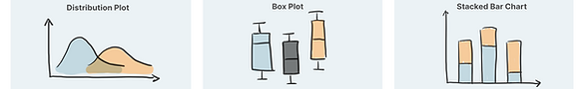
Central Tendency
REPORTING ORDINAL SCALES
You can also use histograms to report the distribution of the answer of single scale items. Boxplots are also a good alternative to show the answer distribution.
1 2 3 4 5
1 2 3 4 5
User Ratings
CHARTS REFLECT THE TEST DESIGN
You can easily present the comparison between the values you collected with bars and boxplots. For factorial tests, you can group bars and boxplots according to one of the factors.
Testing the effect of two layout versions on app usability.
Factor: Layout (with 2 levels)
Testing the effect of two layout versions and user expertise on app usability.
Factors: Layout (with 2 levels) and Expertise (with 2 levels)
SUS Scores
SUS Scores
Version 1 Version 2
Expert Novice Expert Novice
Version 1 Version 2
STATISTICAL TESTS
Statistical tests can be used to report correlations and test hypotheses. The choice of the test will depend on the variable type and its distribution.
Numeric vs. Categorical
2 Treatments
3+ Treatments
Categorical vs. Categorical
T-Test
ANOVA Test
Chi-Squared Test
Or non-parametric tests depending on test design and data distribution
8

Slide 23
Sources:
Downey, A. (2014). Think stats: exploratory data analysis. O'Reilly Media, Inc.
Field, A. (2022). An adventure in statistics: The reality enigma. Sage.

